Slide 1
Application of AC-OPF with SOCP Wind farm-related power distribution network access an ESS Yue Zhao Industrial Engineering Ira A. Fulton Schools of Engineering

Slide 2
Motivation
Understanding the AC-OPF and SOCP.
Comparing Several Relaxation Methods with Julia and PowerModels.
Finding the best bus to locate an ESS in a Wind farm-related power distribution network
.

Slide 3
Optimal Power Flow(OPF)
The goal of an optimal power flow (OPF) is to determine the “best” way to operate a power system. Usually “best” = minimizing operating cost.
Find a Power Flow distribution
Satisfy system operating constraints such as node voltage constraints, branch current/power constraints, generator power constraints, etc.
Find an optimal value for a certain aspect of the index, such as the lowest generation cost or the lowest system network loss
.

Slide 4
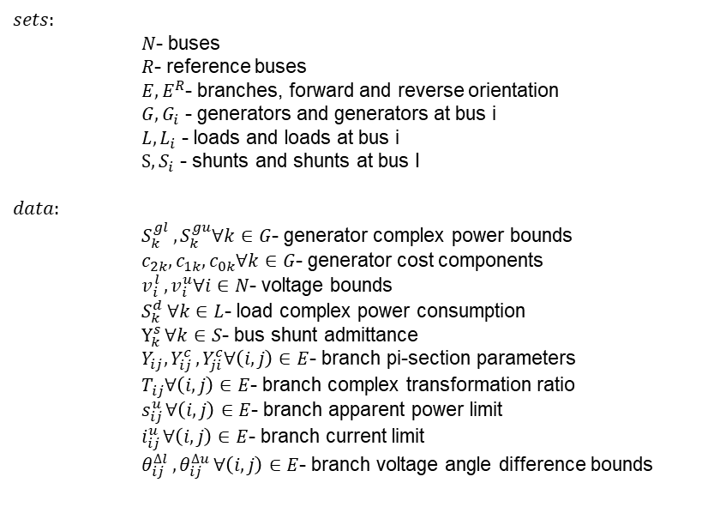
AC Optimal Power Flow(OPF)
$$sets:$$
$N$- buses
$R$- reference buses
$E,E^{R}$- branches, forward and reverse orientation
$G,G_{i}$ - generators and generators at bus i
$L,L_{i}$ - loads and loads at bus i
$S,S_{i}$ - shunts and shunts at bus I
$$data:$$
$S_{k}^{gl }, S_{k}^{gu}∀k∈G$- generator complex power bounds
$c_{2k},c_{1k},c_{0k}∀k∈G$- generator cost components
$v_{i}^{l },v_{i}^{u}∀i∈N$- voltage bounds
$S_{k}^{d }∀k∈L$- load complex power consumption
$Y_{k}^{s }∀k∈S$- bus shunt admittance
$Y_{ij}, Y_{ij}^{c },Y_{ji}^{c}∀\left(i,j\right)∈E$- branch pi-section parameters
$T_{ij}∀\left(i,j\right)∈E$- branch complex transformation ratio
$s_{ij}^{u }∀\left(i,j\right)∈E$- branch apparent power limit
$i_{ij}^{u }∀\left(i,j\right)∈E$- branch current limit
$θ_{ij}^{∆l },θ_{ij}^{∆u }∀\left(i,j\right)∈E$- branch voltage angle difference bounds

Slide 5
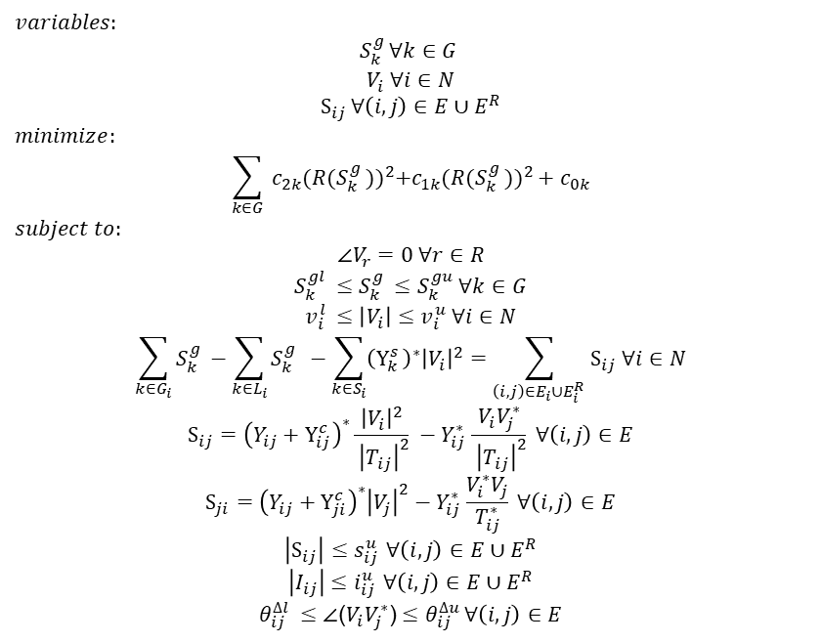
AC Optimal Power Flow(OPF)
$$variables:$$
$$S_{k}^{g }∀k∈G$$
$$V_{i} ∀i∈N$$
$$S_{ij }∀\left(i,j\right)∈E∪E^{R}$$
$$minimize:$$
$$\sum_{k∈G}{{ c_{2k}(R(S_{k}^{g }))}^{2}+{c_{1k}(R(S_{k}^{g }))}^{2}+c_{0k}}$$
$$subject to:$$
$$\text{∠}V_{r}=0 ∀r∈R \\ S_{k}^{gl }≤S_{k}^{g }≤S_{k}^{gu} ∀k∈G \\ v_{i}^{l }≤\left|V_{i}\right|≤v_{i}^{u} ∀i∈N \\ \sum_{k∈G_{i}}{S_{k}^{g }}−\sum_{k∈L_{i}}{S_{k}^{g } −\sum_{k∈S_{i}}{{\left(Y_{k}^{s }\right)}^{∗}{\left|V_{i}\right|}^{2}=\sum_{\left(i,j\right)∈E_{i}∪E_{i}^{R }}{S_{ij} ∀i∈N}}} \\ S_{ij}={\left({Y_{ij}+Y}_{ij}^{c }\right)}^{∗}\frac{{\left|V_{i}\right|}^{2}}{{ \left|T_{ij}\right|}^{2}} −Y_{ij}^{∗ }\frac{V_{i}V_{j}^{∗}}{{ \left|T_{ij}\right|}^{2}} ∀\left(i,j\right)∈E \\ S_{ji}={\left({Y_{ij}+Y}_{ji}^{c }\right)}^{∗}{\left|V_{j}\right|}^{2}−Y_{ij}^{∗ }\frac{V_{i}^{∗}V_{j}}{T_{ij}^{∗}} ∀\left(i,j\right)∈E \\ \left|S_{ij}\right|≤s_{ij}^{u } ∀\left(i,j\right)∈E∪E^{R} \\ \left|I_{ij}\right|≤i_{ij}^{u } ∀\left(i,j\right)∈E∪E^{R} \\ θ_{ij}^{∆l }≤\text{∠}\text{(}V_{i}V_{j}^{∗}\text{)}≤θ_{ij}^{∆u }∀\left(i,j\right)∈E$$

Slide 6


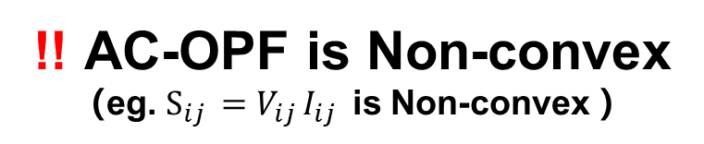
Implementing AC-OPF with Julia and PowerModels
Take MATPOWER's case30.m as an example for testing
!! AC-OPF is Non-convex
（eg. $S_{ij }=V_{ij }I_{ij }$ is Non-convex ）
PowerModels.jl

Slide 7

Quick Comparison of Several Relaxation Methods with Julia and PowerModels
Relaxation Methods
PowerModels.LPACCPowerModel - The LPAC Cold-Start AC Power Flow Approximation
PowerModels.SOCWRPowerModel – the Second-order cone relaxation
PowerModels. QCRMPowerModel – the Recursive McCormik relaxations
PowerModels. QCLSPowerModel - the "Quadratic-Convex" relaxation
Comparison by solve time
.

Slide 8
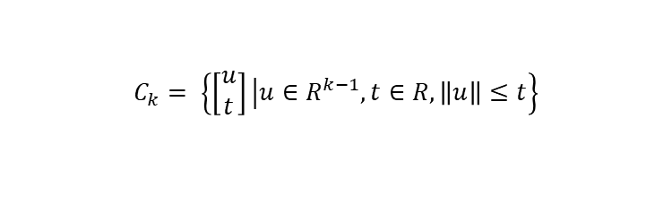
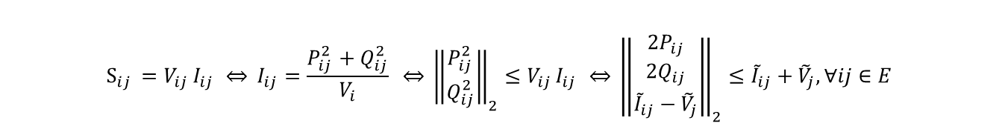

Second-Order Cone Programming(SOCP)
Second-order cone
second-order cone constraint
second-order cone constraint in AC-OPF
$$C_{k}= \left\{\left[\begin{matrix}u \\ t\end{matrix}\right]\left|u∈R^{k−1},t∈R,\left\|u\right\|≤t\right.\right\}$$
$$\left\|Ax+b\right\|≤c^{T}x+d \overset{⇔}{} \left[\begin{matrix}A \\ c^{T}\end{matrix}\right]x+\left[\begin{matrix}b \\ d\end{matrix}\right]∈C_{k}$$
$$S_{ij }=V_{ij }I_{ij } \overset{⇔}{} {I_{ij}=\frac{P_{ij}^{2 }+Q_{ij}^{2 }}{V_{i}} \overset{⇔}{} {\left\|\begin{matrix}P_{ij}^{2 } \\ Q_{ij}^{2 }\end{matrix}\right\|}_{2}≤V_{ij }I_{ij } \overset{⇔}{} \left\|\begin{matrix}2P_{ij} \\ 2Q_{ij} \\ {\tilde{I}}_{ij}−{\tilde{V}}_{j}\end{matrix}\right\|}_{2}≤{\tilde{I}}_{ij}+{\tilde{V}}_{j}, ∀ij∈E$$

Slide 9

AC-OPF with the Second-order cone relaxation
$$\min{f(p,q,P,Q,\tilde{V},\tilde{I})}$$
$s.t.$
$$\left\{\begin{matrix}p_{j}=\sum_{k∈δ(j)}{P_{jk}− \sum_{i∈π(j)}{\left(P_{ij}−{\tilde{I}}_{ij}r_{ij}\right)+g_{j}{\tilde{V}}_{j}}}, ∀j∈B \\ q_{j}=\sum_{k∈δ(j)}{Q_{jk}− \sum_{i∈π(j)}{\left(Q_{ij}−{\tilde{I}}_{ij}x_{ij}\right)+b_{j}{\tilde{V}}_{j}}}, ∀j∈B\end{matrix}\right. \\ {\tilde{V}}_{j}={\tilde{V}}_{i}−2\left(P_{ij}r_{ij}+Q_{ij}x_{ij}\right)+{\tilde{I}}_{ij}\left(r_{ij}^{2}+x_{ij}^{2}\right), ∀ij∈E \\ {\left\|\begin{matrix}2P_{ij} \\ 2Q_{ij} \\ {\tilde{I}}_{ij}−{\tilde{V}}_{j}\end{matrix}\right\|}_{2}≤{\tilde{I}}_{ij}+{\tilde{V}}_{j}, ∀ij∈E \\ {\underline{I}}_{ij}^{2}≤{\tilde{I}}_{ij}≤{\tilde{I}}_{ij}^{2} ,∀ij∈E \\ {\underline{V}}_{j}^{2}≤{\tilde{V}}_{j}≤{\tilde{V}}_{j}^{2} ,∀ij∈B^{+}$$

Slide 10
Wind farm-related power distribution network with 33 buses
Take data from MATPOWER's case33bw
18
19
20
21
SVC
18
19
20
21
25
26
27
28
19
30
31
32
25
26
27
28
19
30
31
32
Wind
1
2
1
2
3
4
5
6
7
8
9
10
11
12
13
14
15
16
17
Wind
3
4
5
6
7
8
9
10
11
12
13
14
15
16
17
18
33
33
22
23
24
OLTC
22
23
24
CB
SVC
CB
SVC

Slide 11
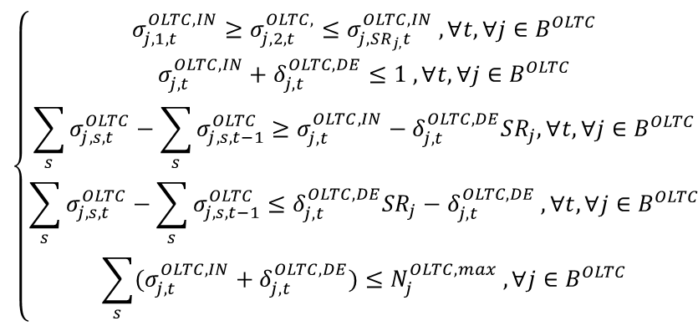
Add OLTC and Constraints
On-Load Tap Changers (OLTC) regulates the voltage value on the low voltage side
With the addition of OLTC, the substation bus node is converted into an adjustable variable.
The following substitutions can be made:
$$\left\{\begin{matrix}\begin{aligned}\begin{aligned}σ_{j,1,t}^{OLTC,IN}≥σ_{j,2,t}^{OLTC,}≤σ_{j,SR_{j,}t}^{OLTC,IN} ,∀t,∀j∈B^{OLTC} \\ σ_{j,t}^{OLTC,IN}+δ_{j,t}^{OLTC,DE}≤1 ,∀t,∀j∈B^{OLTC}\end{aligned} \\ \sum_{s}{σ_{j,s,t}^{OLTC}}−\sum_{s}{σ_{j,s,t−1}^{OLTC}}≥σ_{j,t}^{OLTC,IN}−δ_{j,t}^{OLTC,DE}SR_{j},∀t,∀j∈B^{OLTC}\end{aligned} \\ \begin{aligned}\sum_{s}{σ_{j,s,t}^{OLTC}}−\sum_{s}{σ_{j,s,t−1}^{OLTC}}≤δ_{j,t}^{OLTC,DE}SR_{j}−δ_{j,t}^{OLTC,DE} ,∀t,∀j∈B^{OLTC} \\ \sum_{s}{(σ_{j,t}^{OLTC,IN}+δ_{j,t}^{OLTC,DE})}≤N_{j}^{OLTC, max} ,∀j∈B^{OLTC}\end{aligned}\end{matrix}\right.$$

Slide 12
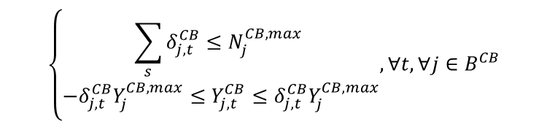
Add Reactive Power Regulator and Constraints
Capacitor Banks(CB)
Static VAR compensation(SVC)
$$\left\{\begin{matrix}\sum_{s}{δ_{j,t}^{CB}}≤N_{j}^{CB,max} \\ −δ_{j,t}^{CB}Y_{j}^{CB,max}≤Y_{j,t}^{CB}≤δ_{j,t}^{CB}Y_{j}^{CB,max}\end{matrix},∀t,∀j∈B^{CB}\right.$$
$$Q_{j}^{SVC,min}≤Q_{j,t}^{SVC}≤Q_{j}^{SVC,max} , ∀t, ∀j∈B^{SVC}$$

Slide 13
Select which bus to add an ESS?
Place the ESS on each bus in turn
Add ESS constraints to the power system model
The objective values are obtained by solving with the CPLEX solver.
Find the minimum objective value and index its bus
Get the best position for ESS

Slide 14
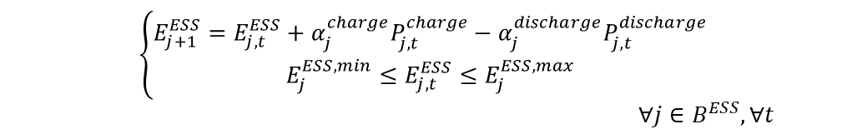
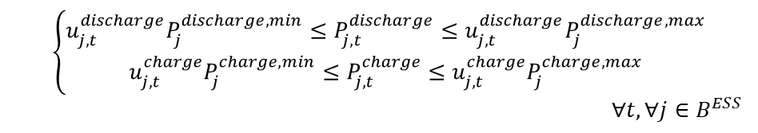
Select which bus to add an ESS?
Charging and discharging mode limitation
Power Limit
Storage Limit
$$u_{j,t}^{discharge}+u_{j,t}^{charge}≤1, ∀j∈B^{ESS}, ∀t$$
$$\left\{\begin{matrix}u_{j,t}^{discharge}P_{j}^{discharge,min}≤P_{j,t}^{discharge}≤u_{j,t}^{discharge}P_{j}^{discharge,max} \\ u_{j,t}^{charge}P_{j}^{charge,min}≤P_{j,t}^{charge}≤u_{j,t}^{charge}P_{j}^{charge,max}\end{matrix}\right.$$ $∀t,∀j∈B^{ESS}$
$$\left\{\begin{matrix}E_{j+1}^{ESS}=E_{j,t}^{ESS}+α_{j}^{charge}P_{j,t}^{charge}−α_{j}^{discharge}P_{j,t}^{discharge} \\ E_{j}^{ESS,min}≤E_{j,t}^{ESS}≤E_{j}^{ESS,max}\end{matrix}\right.$$ $∀j∈B^{ESS},∀t$

Slide 15
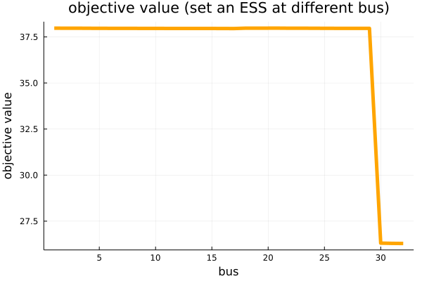

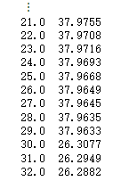
Result
choose 32 bus to set an ESS

Slide 16
Result
18
19
20
21
SVC
25
26
27
28
19
30
31
32
Wind
ESS
1
2
3
4
5
6
7
8
9
10
11
12
13
14
15
16
17
Wind
33
OLTC
22
23
24
CB
SVC
CB
SVC

Slide 17
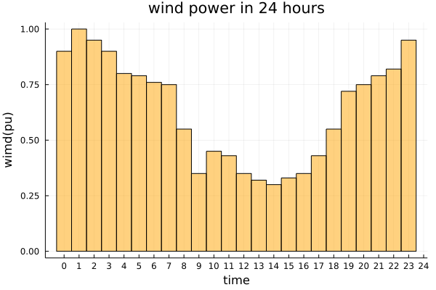
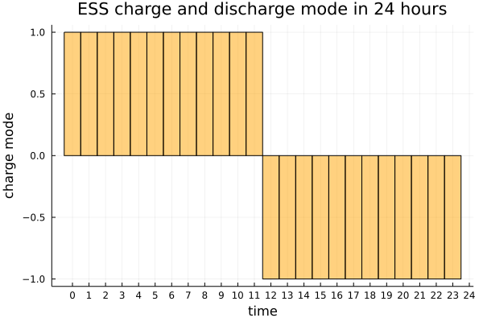
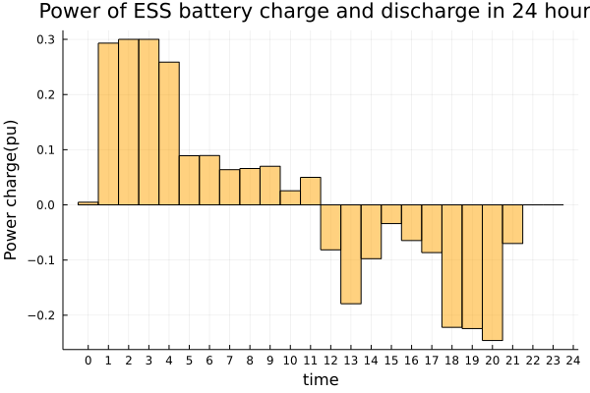
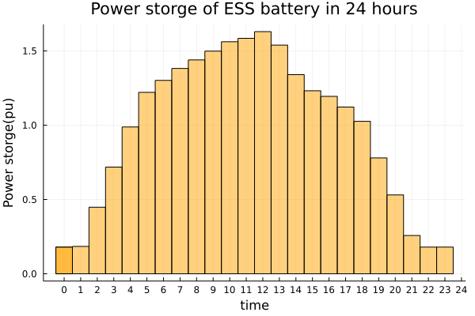
Result

Slide 18
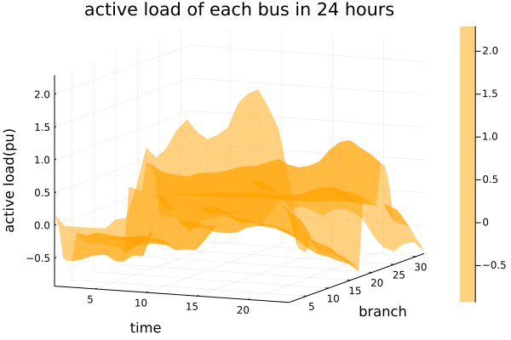
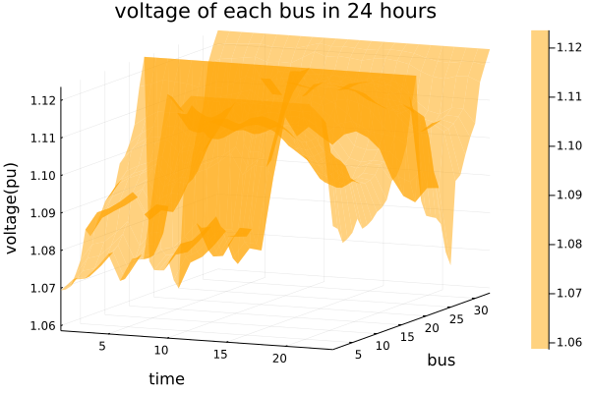
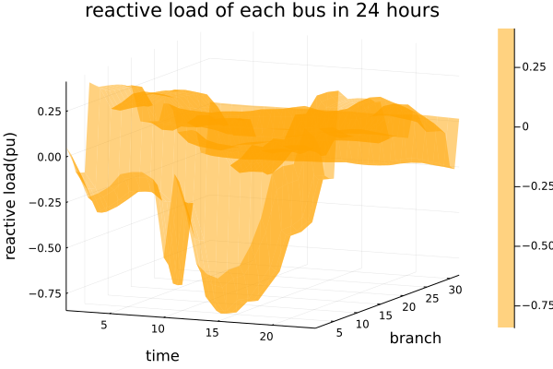
Result

Slide 19
Future Research
Considering a large scale grid
Involving some geographical factors related to a real world case
Adding more constraints to the model, like factors related to the electricity market

Slide 20
References
[1]. Farivar, Masoud, and Steven H. Low. "Branch flow model: Relaxations and convexification—Part I." IEEE Transactions on Power Systems 28, no. 3 (2013): 2554-2564.
[2]. Gao, Hongjun, Junyong Liu, Xiaodong Shen, and R. Xu. "Optimal power flow research in active distribution network and its application examples." In Proceedings of the CSEE, vol. 37, no. 6, pp. 1634-1644. 2017.
[3]. Chertkov, Michael, Deepjyoti Deka, and Yury Dvorkin. "Optimal ensemble control of loads in distribution grids with network constraints." In 2018 Power Systems Computation Conference (PSCC), pp. 1-7. IEEE, 2018.
[4]. Ponoćko, Jelena. Data Analytics-Based Demand Profiling and Advanced Demand Side Management for Flexible Operation of Sustainable Power Networks. Springer Nature, 2020.
[5]. Carpentier, J. "Contribution to the economic dispatch problem." Bulletin de la Societe Francoise des Electriciens 3, no. 8 (1962): 431-447.
[6]. Coffrin, Carleton, and Pascal Van Hentenryck. "A linear-programming approximation of AC power flows." INFORMS Journal on Computing 26, no. 4 (2014): 718-734.
[7]. Jabr, Rabih A. "Radial distribution load flow using conic programming." IEEE transactions on power systems 21, no. 3 (2006): 1458-1459.

Slide 21
References
[8]. Hijazi, Hassan, Carleton Coffrin, and Pascal Van Hentenryck. "Convex quadratic relaxations for mixed-integer nonlinear programs in power systems." Mathematical Programming Computation 9, no. 3 (2017): 321-367.
[9]. Sundar, Kaarthik, Harsha Nagarajan, Sidhant Misra, Mowen Lu, Carleton Coffrin, and Russell Bent. "Optimization-based bound tightening using a strengthened QC-relaxation of the optimal power flow problem." arXiv preprint arXiv:1809.04565 (2018).
[10]. CASE30. Description of case30. (n.d.). Retrieved November 18, 2021, from https://matpower.org/docs/ref/matpower6.0/case30.html.
[11]. CASE33BW. Description of case33bw. (n.d.). Retrieved November 18, 2021, from https://matpower.org/docs/ref/matpower6.0/case33bw.html.
[12]. The powermodels mathematical model. Mathematical Model · PowerModels. (n.d.). Retrieved November 18, 2021, from https://lanl-ansi.github.io/PowerModels.jl/stable/math-model/.

